Slide 1

19ADPN6601 Innovative and Creative project Final Review
Team Number : 23BAD02
Domain : Data science
Title : Predictive Analysis of Product Sales in the Paint Industry
Guide : Dr.N.Suba Rani, Associate Professor,Head AI&DS.
Ms.Indurekaa,AP,AI&DS
Team Members: Viswanathan.R (727621BAD002)
Manoj.R (727621BAD026)
Karunya G.K (727621BAD042)
19ADPN6601 – Innovative and Creative Project

Slide 2
Contents
Problem Statement
Literature Identified and Findings
Objective
Module Description
Software and Hardware Requirements
Data Set
References
Online Certification Courses
Snapshot
Conclusion
19ADPN6601 – Innovative and Creative Project

Slide 3
Problem Statement
The paint industry experiences fluctuations in product demand influenced by various factors such as seasonal changes, economic conditions, and marketing efforts.
By accurately predicting future sales, companies can optimize their inventory management, enhance production planning, and improve strategic decision-making.
19ADPN6601 – Innovative and Creative Project

Slide 4
LITERATURE IDENTIFIED AND
FINDINGS
19ADPN6601 – Innovative and Creative Project

Slide 5
1. Pandas
It has several modules that can be used to carry out data analysis and manipulation.
One powerful module in Python that is used for data manipulation using PANDAS (Python data analysis toolkit).
This module is basically for data analysis
Reference: International Journal of Data Warehousing and Mining Volume 15 • Issue 4 • October-December 2021 Copyright © 2021, IGI Global. Copying or distributing in print or electronic forms without written permission of IGI Global is prohibited. A Comparative Study of Data science Tools
19ADPN6601 – Innovative and Creative Project

Slide 6
2. Numpy
Another module in Python that can be useful when carrying out Financial modeling is the Numpy module.
This module is used for scientific computing with Python.
It has a powerful N-dimensional array object that is useful for large datasets.
It is the fundamental package for scientific computing with Python.
Reference: International Journal of Data Warehousing and Mining Volume 15 • Issue 4 • October-December 2021 Copyright © 2021, IGI Global. Copying or distributing in print or electronic forms without written permission of IGI Global is prohibited. A Comparative Study of Data Cleaning Tools
19ADPN6601 – Innovative and Creative Project

Slide 7
3.Logistic regression
This type of statistical model also known as logit model is often used for classification and predictive analytics.
It is a used to find relationship between two data factors. It uses this relationship to predict the value of one of those factors.
Reference: International Journal of Data Warehousing and Mining Volume 15 • Issue 4 • October-December 2021 Copyright © 2021, IGI Global. Copying or distributing in print or electronic forms without written permission of IGI Global is prohibited. A Comparative Study of Data analysis Tools
19ADPN6601 – Innovative and Creative Project

Slide 8
4. Linear regression
The linear regression analysis uses the mathematical equation, i.e., y = mx + c, that describes the line of best fit for the relationship between y (dependent variable) and x (independent variable).
The regression coefficient, i.e., r2 implies the degree of variability of y due to x.[1-8]
Reference : Schneider A, Hommel G, Blettner M. Linear regression analysis: Part 14 of a series on evaluation of scientific publications. Dtsch Arztebl Int 2010;107:776-82.
19ADPN6601 – Innovative and Creative Project

Slide 9
5. R programming
R is a programming language used for statistical computation
It has been widely used for data analysis.
The R environment has the capacity to read data in several formats and process these files
Reference:International Journal of Engineering Research & Technology (IJERT) Vol. 1 Issue 9, November- 2020
Data Mining Techniques & Distinct Applications: A Literature Review
19ADPN6601 – Innovative and Creative Project

Slide 10
6. Fundamental Analysis
Baresa, Suzana, Sinisa Bogdan, and Zoran Ivanovic had concluded that the Fundamental analysis and historical data are base to predict the future prices of a particular task.
It determines the future prices by analyzing the economy, studying the financial statements of the company and also making sector analysis.
They have also stated that the fundamental analysis did not provide any guarantee of profit in future but it assess the risk possibility prior taking any decisions
Reference:International Journal of Engineering Research & Technology (IJERT) Vol. 1 Issue 9, November- 2020
Data Mining Techniques & Distinct Applications: A Literature Review
19ADPN6601 – Innovative and Creative Project

Slide 11
7. Paint Sector Insights
J.Mounika Reddy, Dr.K.Sowmya, have researched the fundamental analysis of the Paint Sector and found that the inflation rate has been declined which results minimum increase on the cost of raw material and other expenses.
It is found that the prices of selected companies are more than the intrinsic value which is not benefited for long term investment but one may purchase it for short term as to get profit from speculation.
Reference:
Baresa, Suzana, Sinisa Bogdan, and Zoran Ivanovic. 2013. Strategy of stock valuation by fundamental analysis . Special issue, UTMS Journal of Economics 4 (1): 45–51.
19ADPN6601 – Innovative and Creative Project

Slide 12
8. Financial Statement Analysis
Dyna Seng, Jason R. Hancock, have researched that the information included in financial statements is useful for determining earnings or changes.
This data helps to predict future earnings. Sometimes there is scope for abnormal returns.
There is always association between earnings and returns. Earning predictability would imply return predictability.
Reference:
J.mounika Reddy, Dr.K.Sowmya, fundamental analysis on select paint companies , Volume 6, Issue 6 (June, 2016) (ISSN 2231-4334) International Journal of Research in IT & Management (IMPACT FACTOR – 5.96) International Journal of Research in IT & Management
19ADPN6601 – Innovative and Creative Project

Slide 13
Objective
To analyze provided data to predict sales volume and key points of products over time, uncover seasonal sales trends, forecast product demand using historical data, and assess how external factors influence sales.
Through Advanced Analytics, it aims to offer insights to enhance inventory management,marketing strategies, and overall business decisions.
19ADPN6601 – Innovative and Creative Project

Slide 14
Block Diagram
Data Set
Data Preprocessing
Feature Engineering
Model Building
Model Evaluation
Deployment
19ADPN6601 – Innovative and Creative Project

Slide 15
Module Description
1. Data Preprocessing Module: Cleans and prepares historical sales data for analysis. This includes handling missing values, normalizing data, and encoding categorical variables.
2. Feature Engineering Module: Develops new features from the existing data that are more predictive of the target variable. This could include rolling averages of sales, lag features, and indicators of major sales events or holidays.
19ADPN6601 – Innovative and Creative Project

Slide 16
3. Model Building Module: Implements several machine learning algorithms to find the best model for predicting future sales. This module will experiment with regression models, tree-based models, and ensemble methods.
4. Model Evaluation Module: Assesses the performance of different models using metrics such as RMSE (Root Mean Square Error) and MAE (Mean Absolute Error). The best-performing model is then selected for deployment.
5. Deployment Module: Integrates the predictive model into the existing IT infrastructure so that it can be used to make real-time predictions. This includes setting up a model serving infrastructure and creating APIs for easy access to predictions.
19ADPN6601 – Innovative and Creative Project

Slide 17
Requirements
Software requirements:
Windows 10
JUPYTER notebook
Hardware requirements:
Processor – i5
Hard Disk – 4 GB
Memory – 2GB RAM
19ADPN6601 – Innovative and Creative Project

Slide 18
Data Set
The data set named as “Sample data”, it fully describes about the sales history of various paint Industry.
Features:
1. Date: This column represents the date of the transaction and could be used to capture any temporal patterns in the data.
2. ContractorCode, Contractor Name, Contractor Mobile, Dealer Code, Dealer Name, Dealer Mobile: These columns provide information about the contractors and dealers involved in the transactions, which could be used to identify patterns related to specific contractors or dealers
19ADPN6601 – Innovative and Creative Project

Slide 19
3. Depot, Area Unit Code: These columns contain location information that could be used to capture spatial patterns in the data.
4. Call Type: This column represents the type of call and could be used to capture patterns related to different call types.
5. Volume Columns: Columns representing the volume of different products sold could be used as features for prediction
19ADPN6601 – Innovative and Creative Project

Slide 20
Reference
1] Reality Check: Still Spending More Time Gathering Instead Of Analyzing.https://www.forbes.com/sites/forbestechcouncil/2019/12/17/reality-check-still-spending-more-time-gathering-instead-of-analyzing/?sh=6e04fbf428ff. Accessed: 2021.
[2] Bojan Karlaˇs et al. Nearest Neighbor Classifiers over Incomplete Information: From Certain Answers to Certain Predictions. 2020. arXiv: 2005.05117 [cs.LG].
[3] S. Krishnan et al. “Fast and Reliable Analytics on Dirty Data”. In: IEEE Data Eng. Bull. 38 (2015), pp. 59–75.
[4] Sanjay Krishnan et al. “Activeclean: An interactive data framework for modern machine learning”. In: Proceedings of the 2016 International Conference on Management of Data. 2016, pp. 2117–2120
19ADPN6601 – Innovative and Creative Project

Slide 21
Reference
[5] Theodoros Rekatsinas et al. “Holoclean: Holistic data repairs with probabilistic inference”. In: arXiv preprint arXiv:1702.00820 (2017).
[6] benefits of data visualization. https://rockcontent.com/blog/benefits-data-visualization/. Accessed: 2021.
[7] https://www.educative.io/blog/what-is-data-cleaning. Accessed: 2021
19ADPN6601 – Innovative and Creative Project

Slide 22
Online Certification Courses
NAME (ROLL NO) | COURSE NAME | PLATFORM | No. OF WEEKS | REMARKS/ STATUS
Viswanathan R (727621BAD002) Manoj (727621BAD026) Karunya G.K (727621BAD042) | Data analytics with python Foundations of Data Science Data analytics using python | NPTEL Google NPTEL | 12 Weeks 12 Weeks 12 Weeks | Completed Completed Completed

Slide 23
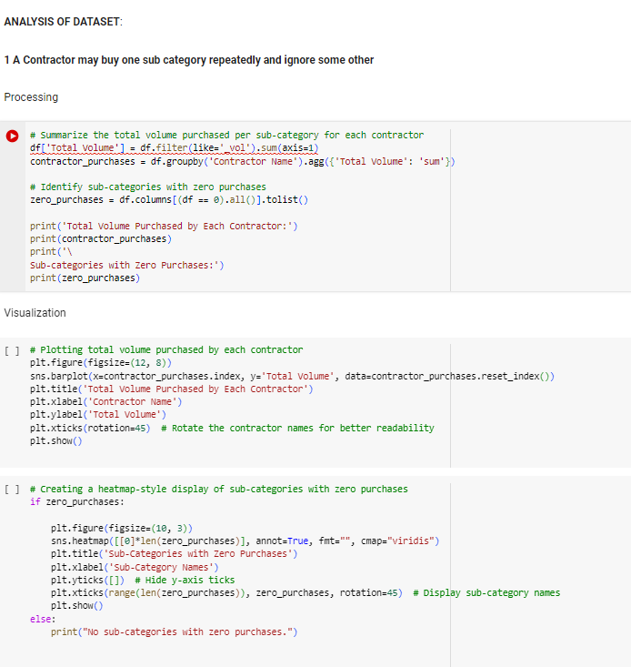
19ADPN6601 – Innovative and Creative Project

Slide 24
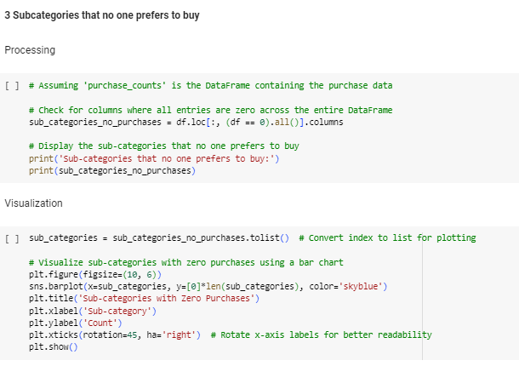
19ADPN6601 – Innovative and Creative Project

Slide 25
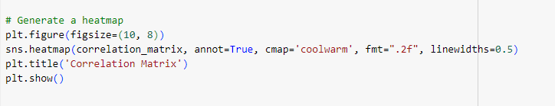
19ADPN6601 – Innovative and Creative Project

Slide 26
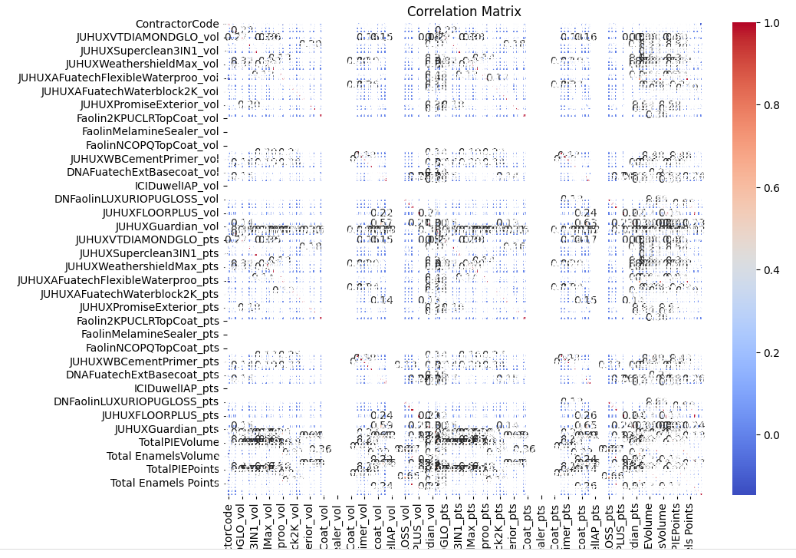
19ADPN6601 – Innovative and Creative Project

Slide 27
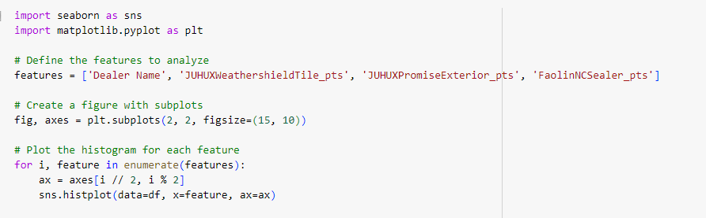
19ADPN6601 – Innovative and Creative Project

Slide 28
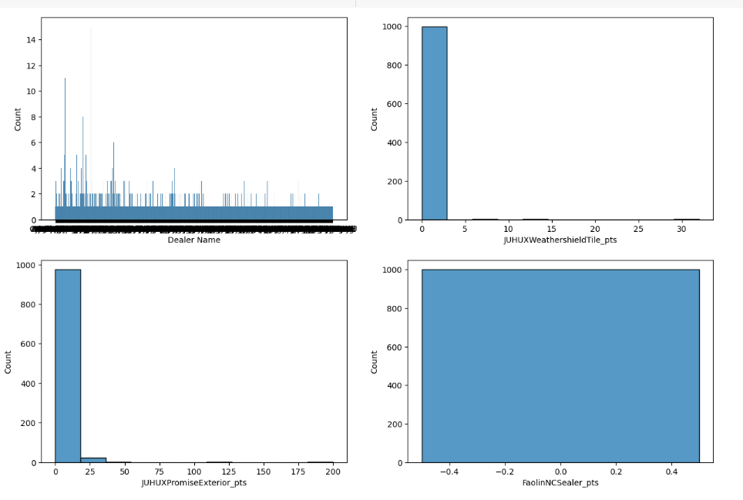
19ADPN6601 – Innovative and Creative Project

Slide 29
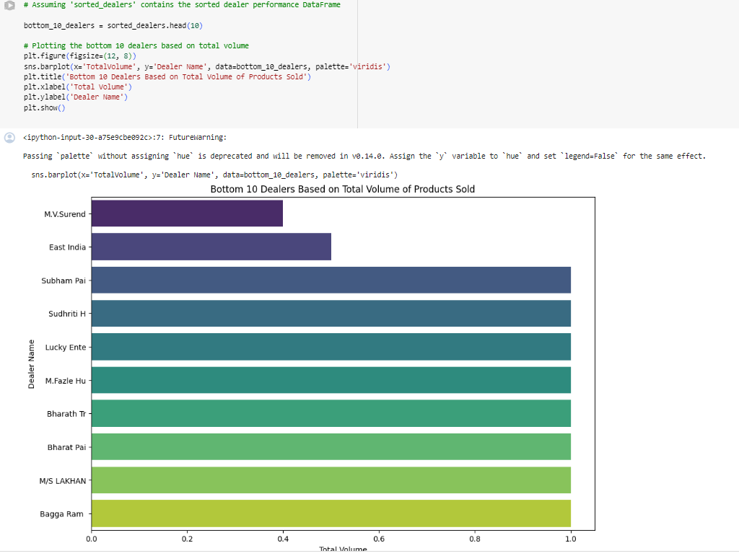
19ADPN6601 – Innovative and Creative Project

Slide 30
Conclusion
The predictive model developed in this project will enable stakeholders in the paint industry to anticipate market demands more accurately.
This foresight will help in reducing inventory costs, minimizing stock-outs, and ensuring that production aligns with market demand. Ultimately, this project will contribute to more efficient operations and increased profitability for companies within the industry.
19ADPN6601 – Innovative and Creative Project

Slide 31
Thank you!
19ADPN6601 – Innovative and Creative Project

